Slide 1
Chapter Two The Main Computer Parts
Basrah University
By Rawan Saleh Ismael
M.Sc. Computer science

Slide 2
Software: System software
Collection of programs
Designed to do specific task
Prepared by manufacturer
Low level language
Serves as the interface btn the hardware & software

Slide 3
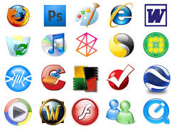
Example of System Software
Operation system : DOS, Windows, UNIX, LINUX, MAC, Android .
Utility :
small programs,
simple task,
editor allows the user open file and write
Exp: Internet explorer, disk clean up

Slide 4
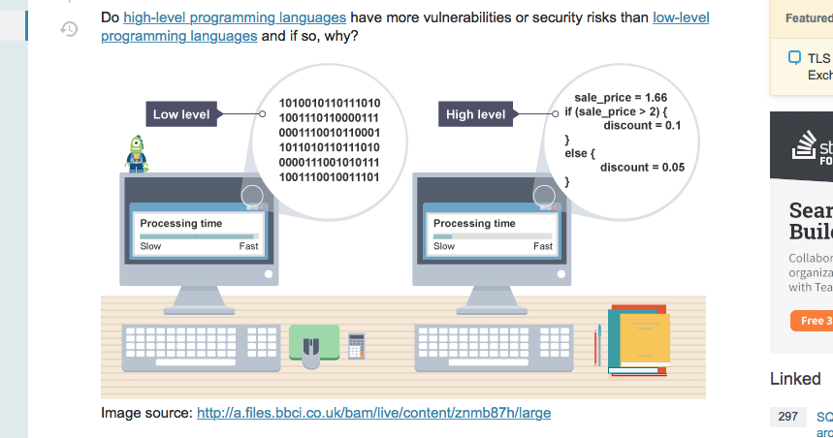
Compilers Programs:
translate program
Basic, Pascal, Fortran
Converts main programs to machine language (object program)

Slide 5
Features of system software
Close to the system
Fast in speed
Difficult to design and understand
Less interactive
Smaller in size
Difficult to manipulate
Written in low level language

Slide 6
Application software
Designed to satisfy a particular need and environment
Single program : Microsoft’s notpad
Collection of programs : spreadsheet package

Slide 7
Features
Close to the user
Easy to design
More interactive
Slow in speed
Written in high level languages
Easy to understand and manipulate
Bigger , required size

Slide 8
Language type
Machine language
Assembly language
High level language

Slide 9
Machine language
Collection of binary digits
Only language computer understand
Computer program
Compiled
Machin language
C++
Java
VB

Slide 10
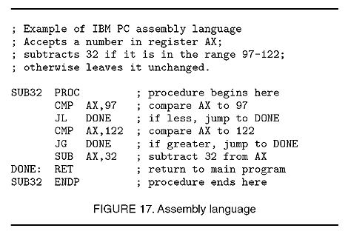
Assembly Language
Particular order
Different from computer to another
Using Assembler to convert it into machine language
Translate a program to object program

Slide 11
High level Languages
Designed to simplify computer processing
Easy to read syntax
Run on computer processor
Must be processed by compiler
C++, Java, Python, C…..
Designed for desktop software, mobile , websites …

Slide 12
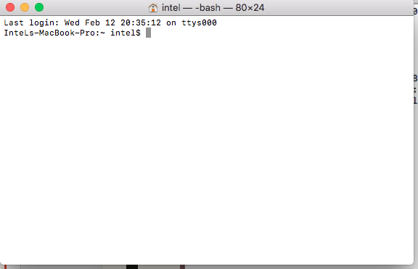

Slide 13
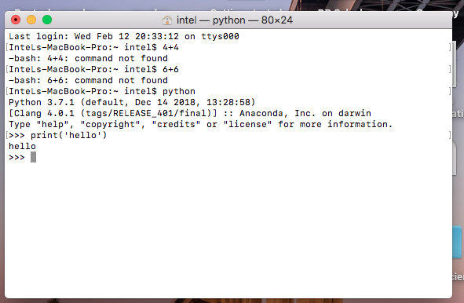

Slide 14
http://www.belpercomputing.com/year-10/ocr-gcse-computer-science/term-1/inside-the-cpu/
https://www.learncomputerscienceonline.com/central-processing-unit/

